Slide 1
Individual Homework
Burca Olivia – 912

Slide 2
Predicate Resolution
Exercise 1 → ∃ ¬ ∀ ≡
Transform the following formulas into prenex, Skolem and clausal normal forms.
1.2 : U = (∃x)(∀y)((∃z)¬ P(z) v (∃u)(R(x,u)→ (∀z)¬ Q(u,z)))

Slide 3

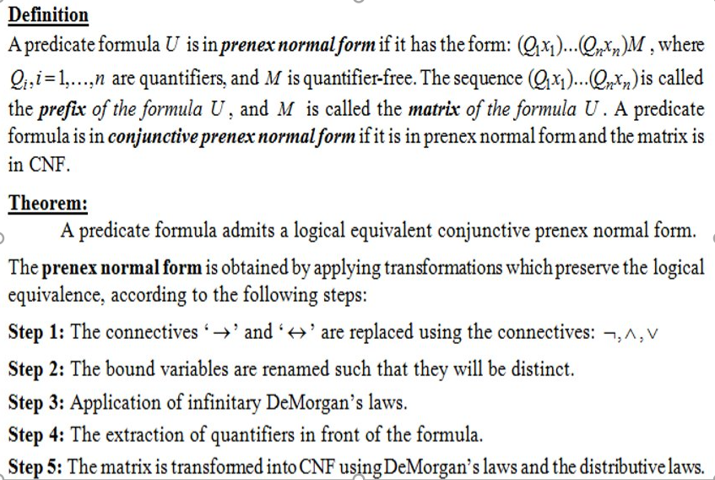
Theoretical results
Prenex normal form

Slide 4
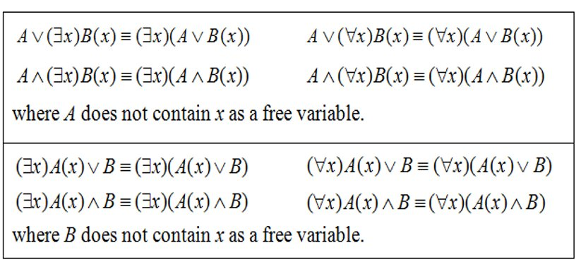
Extraction of quantifiers in front of the formula

Slide 5
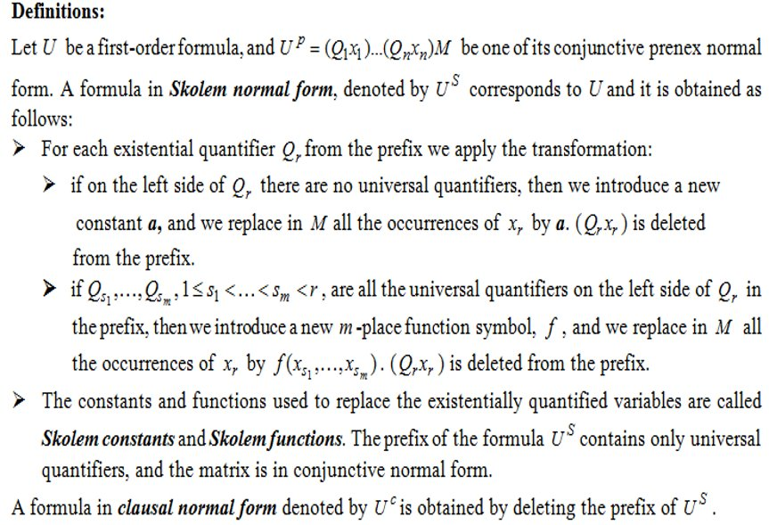
Skolem and clausal normal forms

Slide 6
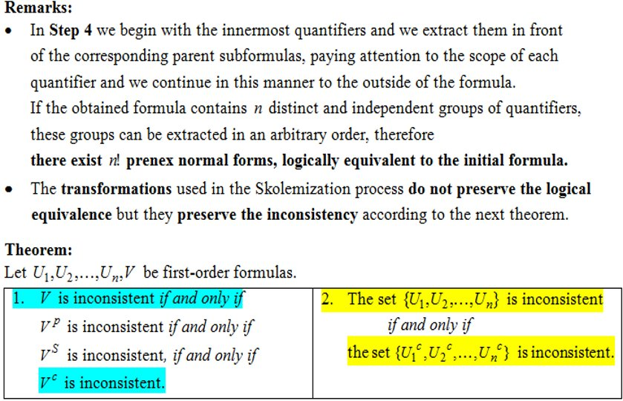

Slide 7
U = (∃x)(∀y)((∃z)¬ P(z) v (∃u)(R(x,u)→ (∀z)¬ Q(u,z)))
Replace →
≡ (∃x)(∀y)((∃z)¬ P(z) v (∃u)(¬ R(x,u) v (∀z)¬ Q(u,z)))
Rename the bound variables, such that they are distinct
≡ (∃x)(∀y)((∃z)¬ P(z) v (∃u)(¬ R(x,u) v (∀t)¬ Q(u,t)))
Extract the quantifiers in front of the formula
≡ (∃x)(∀y)((∃z)¬ P(z) v (∃u)(∀t)(¬ R(x,u) v ¬ Q(u,t)))
There are 2 groups of distinct and independent quantifiers inside the big paranthesis: (∃z) and (∃u)(∀t) and they can be extracted in 2 different ways.

Slide 8
U^{p1} = (∃x)(∀y)(∃u)(∀t)(∃z)(¬ P(z) v ¬ R(x,u) v ¬ Q(u,t))
Skolemization Process
U^{s1} = (∀y)(∀t)(¬ P(g(y,t)) v ¬ R(a,f(y)) v ¬ Q(f(y),t))
[ x <-- a], [u <-- f(y)]. [z <-- g(y,t)]
a – Skolem constant, f,g – Skolem functions
Clausal form
U^{c1} = ¬ P(g(y,t)) v ¬ R(a,f(y)) v ¬ Q(f(y),t)

Slide 9
U^{p2} = (∃x)(∀y)(∃z)(∃u)(∀t)(¬ P(z) v ¬ R(x,u) v ¬ Q(u,t))
Skolemization process
U^{s2} = (∀y)(∀t)(¬ P(f(y)) v ¬ R(a,g(y)) v ¬ Q(g(y),t))
[ x <-- a], [z <-- f(y)]. [u <-- g(y)]
a – Skolem constant, f,g – Skolem functions
Clausal Normal Form
U^{c2} =¬ P(f(y)) v ¬ R(a,g(y)) v ¬ Q(g(y),t)

Slide 10
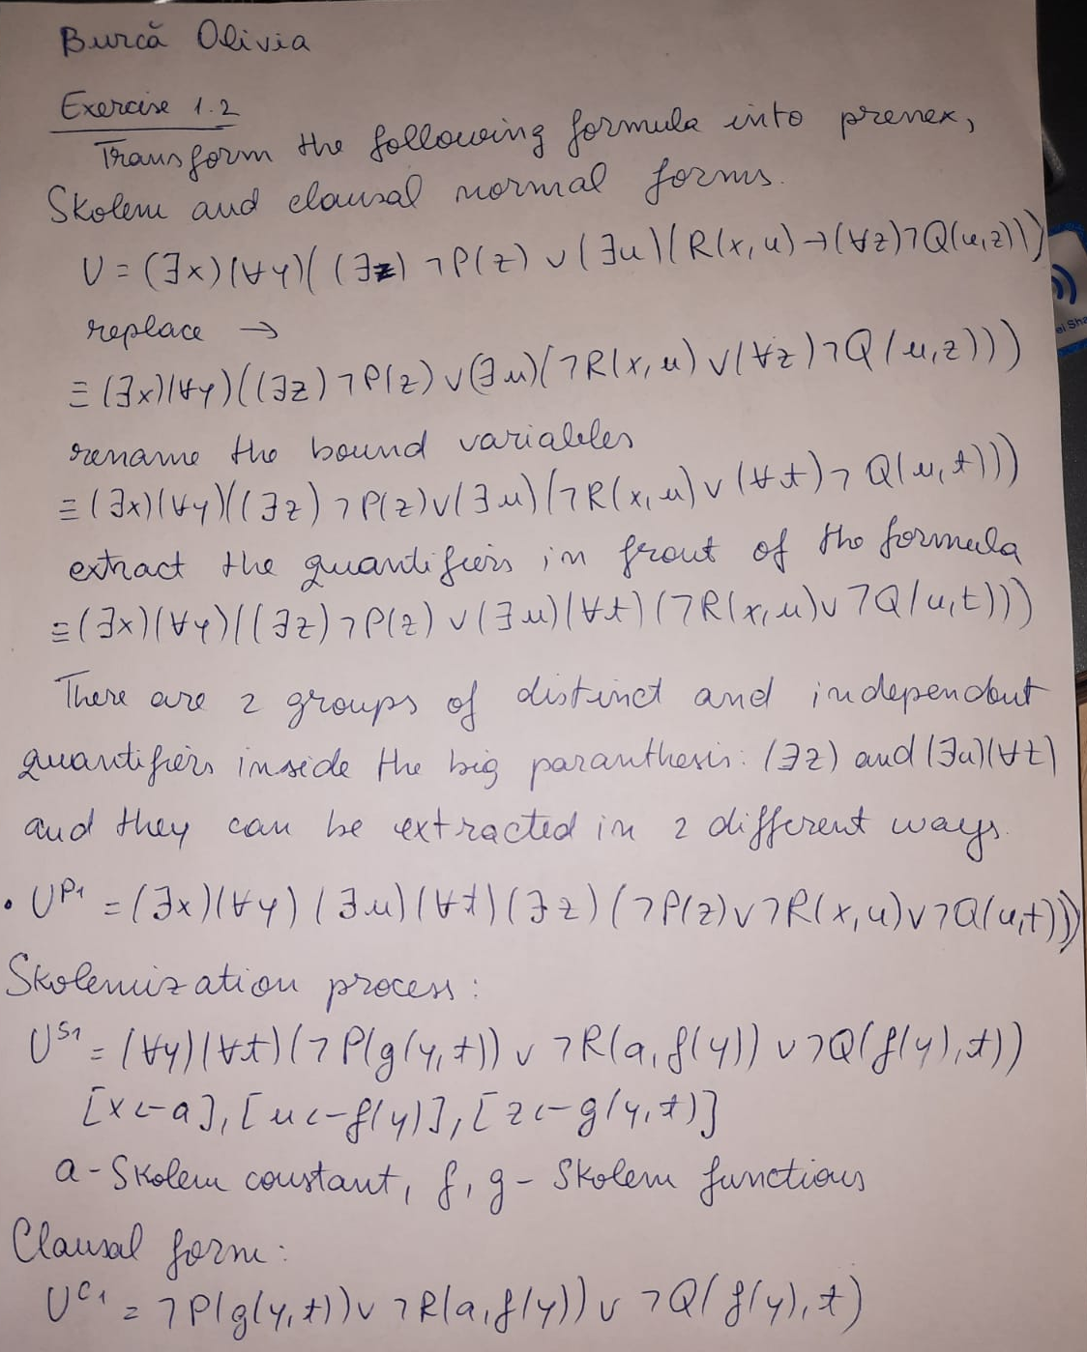
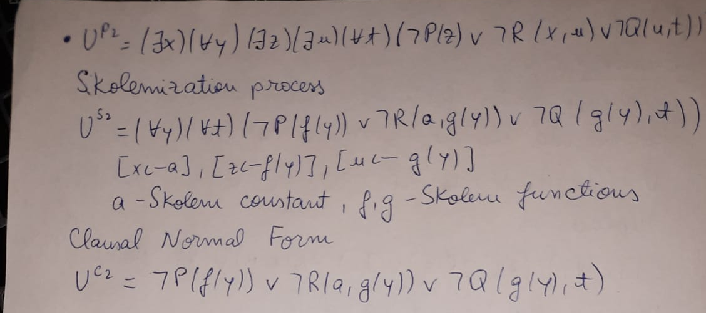
Handwritten Exercise

